Slide 1
ILDG Hands-On Workshop Introduction
T. Yoshie for ILDG
CCS, Tsukuba
June 14, 2023

Slide 2
Welcome to Hands-On workshop
Purpose of Workshop
ILDG is under reactivation and modernization
Hands-On workshop as an opportunity of better communications between (potential) users and developers.
… … …
Purpose of this talk
to get a whole picture of the ILDG
to get familiar with technical words for better understanding of the forthcoming lectures and exercises

Slide 3
Contents of this Introduction
Motivation and Aims of ILDG
History
Strategy/Concepts/Components
Global Structure
Current ILDG
Towards ILDG2
Concluding Remarks

Slide 4
Motivation and Aims of ILDG
ILDG is a framework to share precious lattice data worldwide
ILDG is a framework of international collaboration, aiming at e.g. – enhance Quality of lattice data management – satisfy Requirements of funding agencies – improve Visibility of (and credits for) data generation efforts
(See next lecture for FAIR, a guideline for scientific data management)
Two types/categories of data sharing
sharing data within research group (collaboration)
Share any type of data with local rules on data format, file name, document ,,,,
sharing data in the community but worldwide
Community-wide rules to exchange data, (start with) simple but precious data i.e. QCD ensembles/configurations
ILDG primarily intends the 2nd type of data sharing
(1st type of data sharing is supported by some of RGs)

Slide 5
valuable efforts
Short History
valuable efforts
proposed to the community at Lattice 2002 by R. Kenway (UKQCD)
1st workshop at EPCC, Edinburgh in Dec. 2002
metadata & middleware working groups
ILDG board in 2003
Start to construct the ILDG as a grid of 5 regional grids (RGs)
Valuable effort by working groups (video, email) biannual workshops (video)
ILDG in full operation (as interoperable 5 RGs) in 2007
~ 10 years of high activity (in working groups, workshops, users…)

Slide 6
Short History
Stagnation begun ~ 2017
RG services gradually suspended
Mainly due to lack of man-power
to maintain/update system software
to keep up-to-date with new technologies
Proposal to reactivate ILDG by two WGs in 2022
Needs to access public configurations encouraged
Towards ILDG2 in 2022/2023
Reorganization of WGs and Board, regular meetings
Agree to inherit basic policies of ILDG1 and reform it with new idea/standards/technologies

Slide 7
Design Strategy/Basic Concepts
a Grid of autonomous Regional Grids (RGs)
Autonomous in (system HW and SW, admin and operation, budget,…)
Common rules of data and metadata
Common interface (API to access (meta-)data from clients)
LDG
metadata database
Visit each RG to find an ensemble you want, and identify RG which has the ensemble
storage system
(regional grid)
JLDG
user
metadata database
storage system
(regional grid)
download configurations
from the RG storage system via e.g. gridftp
・・・・・・

Slide 8
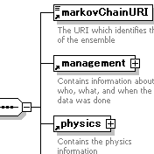
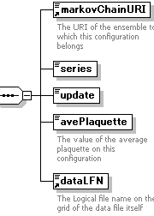
Common Rules for Data and Metadata
mc://JLDG/nf2/b205k1356
ensemble
XML
configuration
XML
QCDml: XML markup language for
QCD ensembles/configurations metadta
<npClover>
<kappa>0.1354</kappa>
<cSW> 1.684 </cSW>
</npClover>
markovChainURI and data LFN:
Logical names of ensemble/configs,
and keep correspondence of (meta-) data
configuration file
lfn://JLDG/nf2/b205k1356-A200
file-format XML
size, precision
packed
with LIME
configuration binary data
Lattice QCD Interchange
Message Encapsulation
(B.Joo and C.DeTar)
lfn://JLDG/nf2/b205k1356-A200

Slide 9
Middleware components and interface
Metadata Catalogue
Storage
Elements
SRM: Storage Resource Manager
http://sdm.lbl.gov/srm-wg/
SRM
a query language for selecting
nodes from an XML document
Each RG has two types
of Databases
Metadata Catalogue (MDC)
File Catalogue (FC)
to support data replication
(See later lectures)
SURL
web service interface
XPath
TURL
markovChainURI
LFN
gridftp, http
servers
SURL: site uniform
resource locator
TURL: transfer URL
TURL
LFN
SURL
data
web service interface
VOMS: is used to access
control to Storage and FC
(See next slide)
Authentication
VOMS
virtual organization
management system
File Catalogue

Slide 10
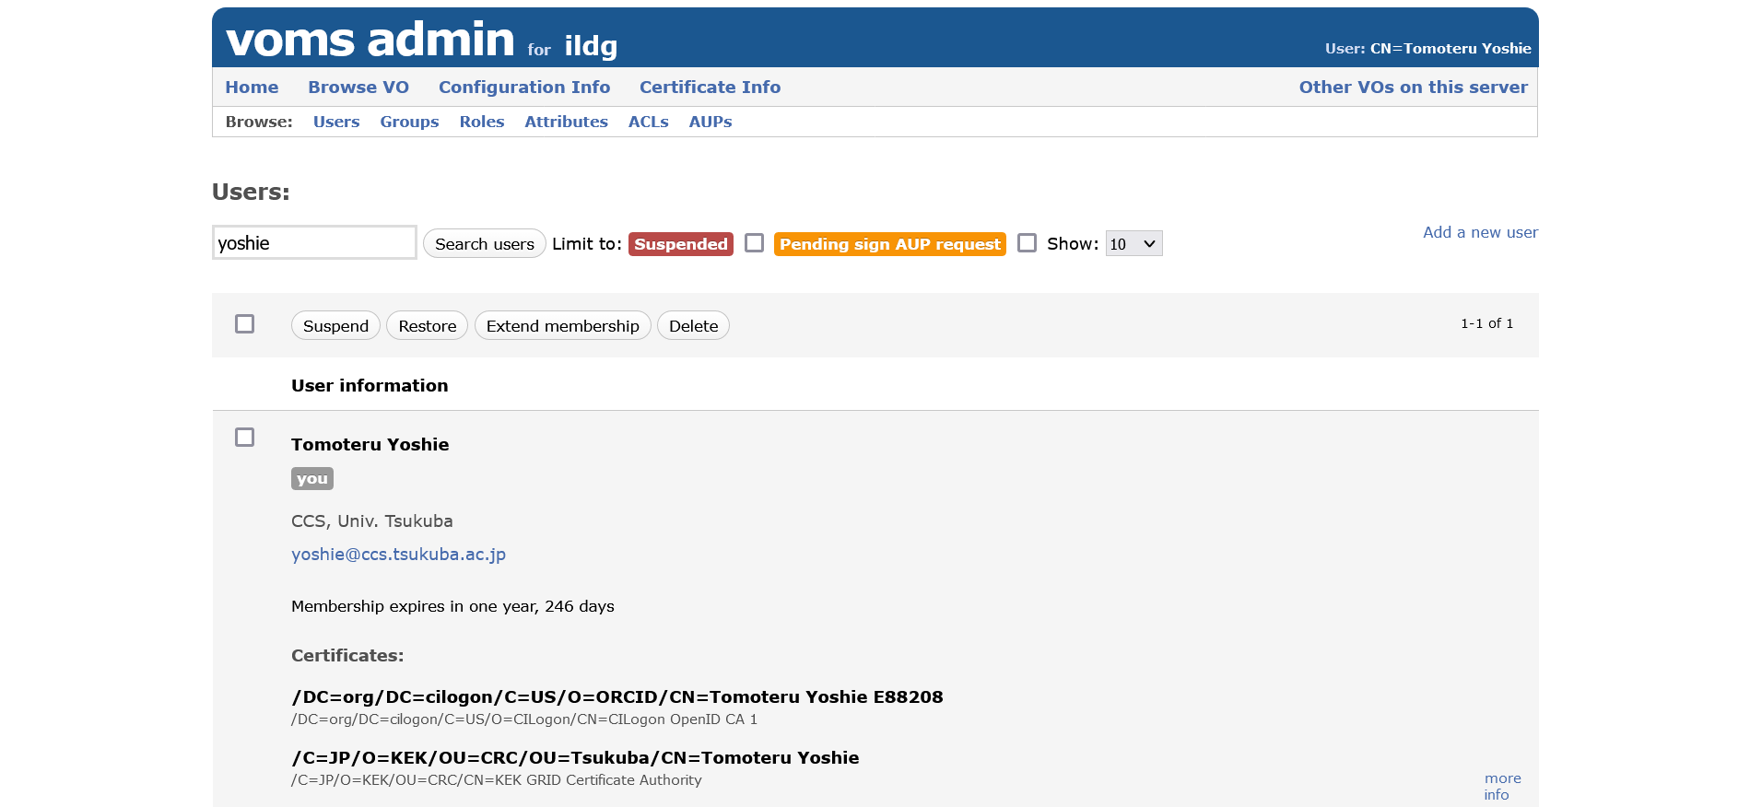
Virtual Organization
Is Access Control necessary?
Yes: if ILDG is used for daily research to share unpublished data within collaboration
Yes: guarantee access to ILDG is made from members of lattice physics community
No: if ILDG publishes public data only
VOMS
keep data of ILDG users and roles/groups of user
authentication is made when access to File Catalogue and Storage elements
Identity of a user by an X509 certificate of GT4 GSI
Authorization by VO admins of Regional Grids

Slide 11
Other components
Services.xml
master catalogue to keep locations of RG catalogue services
ILDG web page
Portals to ILDG DB
are not ILDG standards, but are useful clients
help users find ensembles
Simple listing,
narrowing search, … (See exercises)

Slide 12
Submitting Ensemble/Configs to ILDG
no standardized procedure
RG has its own procedure/rule
the procedure includes
determine MarkovChainURI/LFN following RG rules
convert config’s to the ILDG standard format
place the config files on one of Storage elements
write ensemble/config XML documents
update Metadata Catalogue and File Catalogue databases

Slide 13
Current ILDG
Current ILDG
LDG, JLDG, UKQCD, USQCD, CSSM (what to mention, need to compile status of RGs

Slide 14
Towords ILDG2
Towards ILDG2
– relax authentication (grid certificate → idp+AAI) – relax QCDml (QCD markup language, a rule set to describe ensemble/config metadata) – DOI (digital object identifier) registration – other modernization and extensions

Slide 15
Concluding Remarks
Concluding Remarks
data consumer vs. data provider – restricted (within or between collaborations) vs. public sharing – work in progress – not a service but a community effort 3

